Slide 1
Clocks

Slide 2
Distributed Synchronization
Communication between processes in a distributed system can have unpredictable delays, processes can fail, messages may be lost.
Synchronization in distributed systems is harder than in centralized systems because the need for distributed algorithms.
Properties of distributed algorithms:
1 The relevant information is scattered among multiple machines.
2 Processes make decisions based only on locally available information.
3 A single point of failure in the system should be avoided.
4 No common clock or other precise global time source exists.

Slide 3
Challenge:
How to design schemes so that multiple systems can coordinate/synchronize to solve problems efficiently?

Slide 4
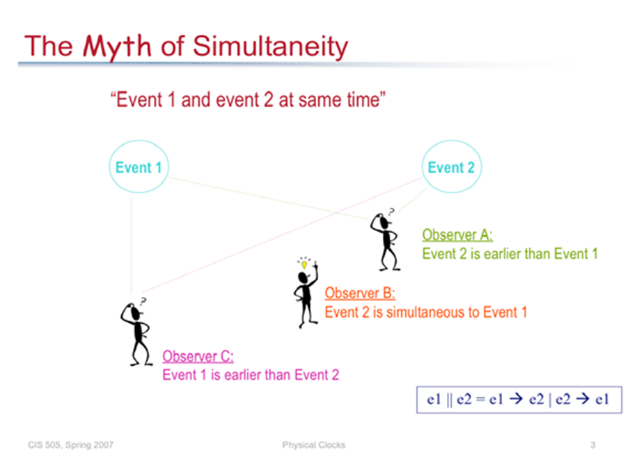

Slide 5
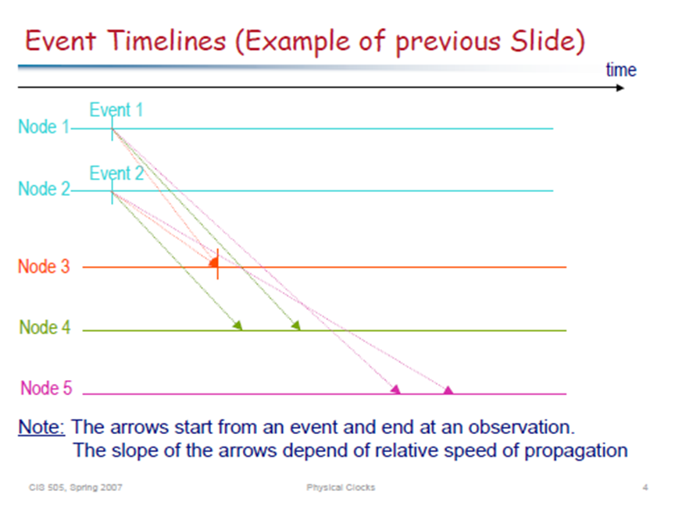

Slide 6
Absence of global clock
No system-wide common clock (global clock).
Reasons:
  Suppose a global clock exists. Two different processes can observe the clock at different times due to unpredictable message delays. Hence two different instances in physical time may be perceived as a single instance in physical time.
  If each process has a local clock and we try to synchronize them, they may drift due to technological limitations. Hence two different instances in physical time may be perceived as a single instance in physical time.
Dept. of IT, Jadavpur University

Slide 7
Impact of the absence of global time
Concept of temporal ordering of events is ubiquitous. Suddenly it disappeared.
Scheduling of processes by an OS depends on the temporal order of process arrival.
Difficult to design and debug distributed programs since it is difficult to reason about temporal order of events in distributed systems.
Without a global clock, difficult to collect up-to-date information on the state of the entire system.
Dept. of IT, Jadavpur University

Slide 8
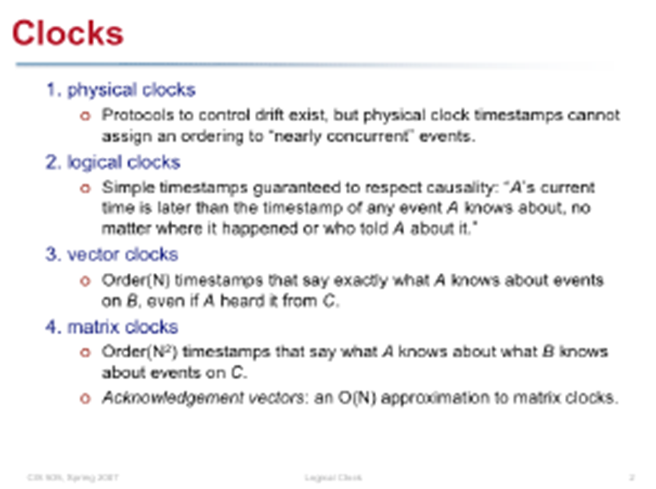

Slide 9
Physical Clocks

Slide 10
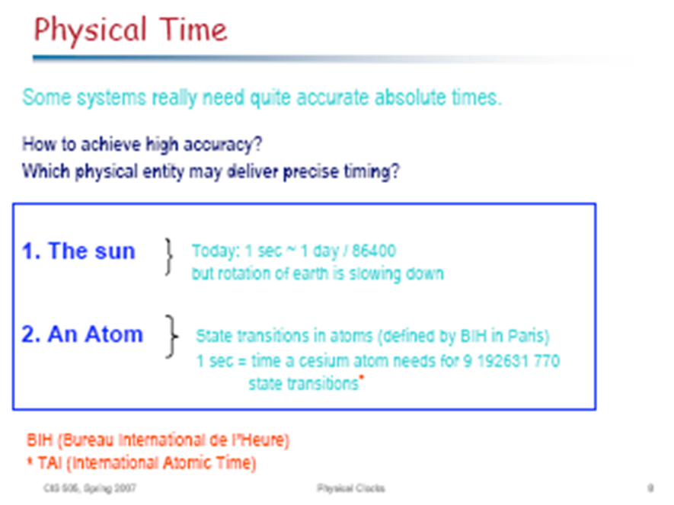

Slide 11
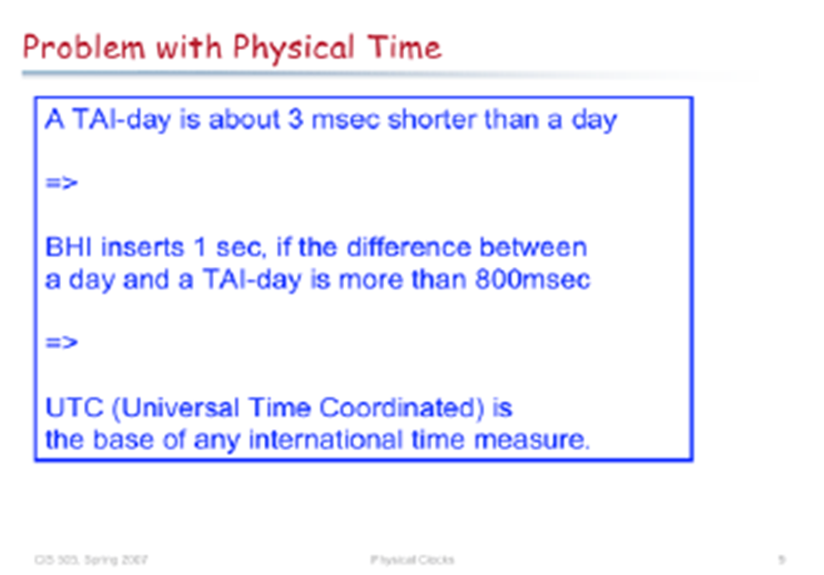

Slide 12
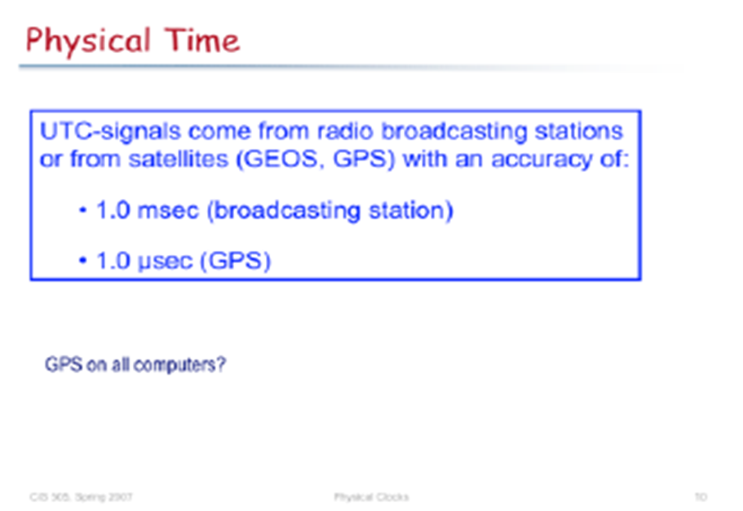

Slide 13
Clock Skew Problem
Clock skew (offset) : Difference between the readings of any two
clocks.
Clock’s drift rate : They count time at different rates. It is the
change in the offset (difference in reading)
between the clock and a nominal perfect
reference clock per unit of time measured by
the reference clock.
For ordinary clocks based on a quartz crystal this is about 10^{–6} seconds/second, giving a difference of 1 second every 1,000,000 seconds, or 11.6 days.
The drift rate of ‘high-precision’ quartz clocks is about 10^{–7} or 10^{–8}.

Slide 14
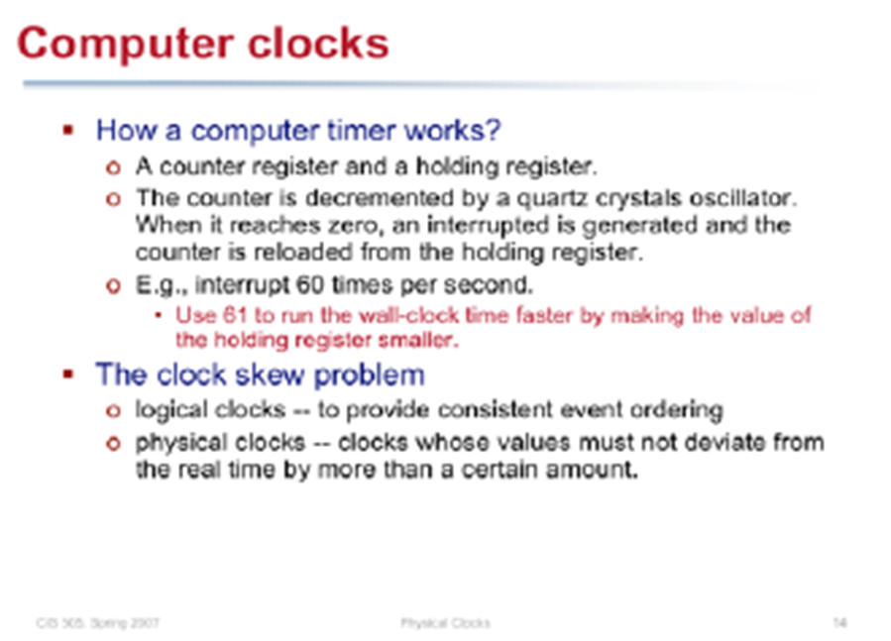

Slide 15

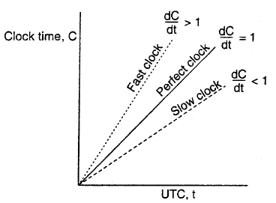
Physical clock drift rate
Maximum drift rate:
One can determine how often they should be synchronize
C= value of the clock at UTC
time t.
ρ= Maximum drift rate (i.e., to
what extent a clock’s skew
is allowed to fluctuate).
N.B.: Not all clocks tick precisely at the current rate.

Slide 16
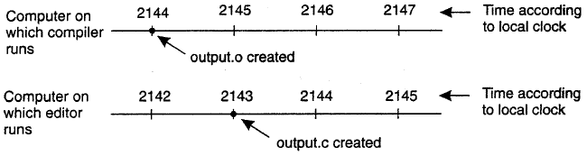
Why need to synchronize clocks?
When each machine has its own clock, an event that occurred after another event may nevertheless be assigned an earlier time.
Hence, all that really matters are the relative times.

Slide 17
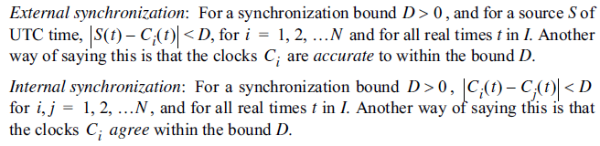
Clock Synchronization

Slide 18
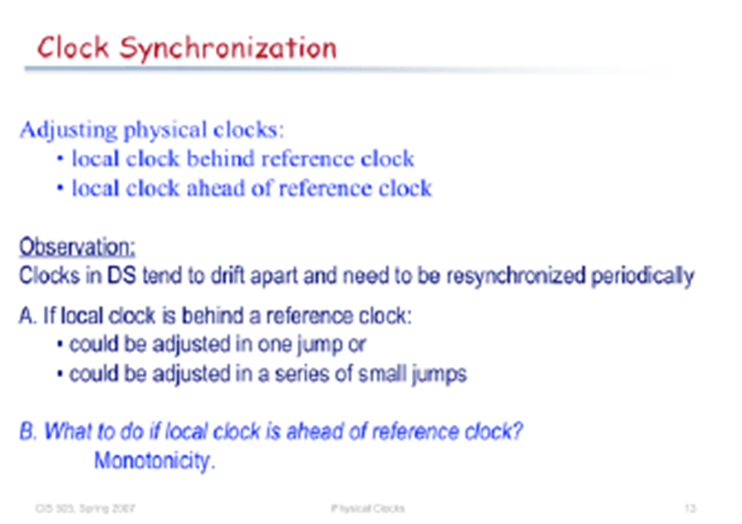

Slide 19
Logical Clocks

Slide 20
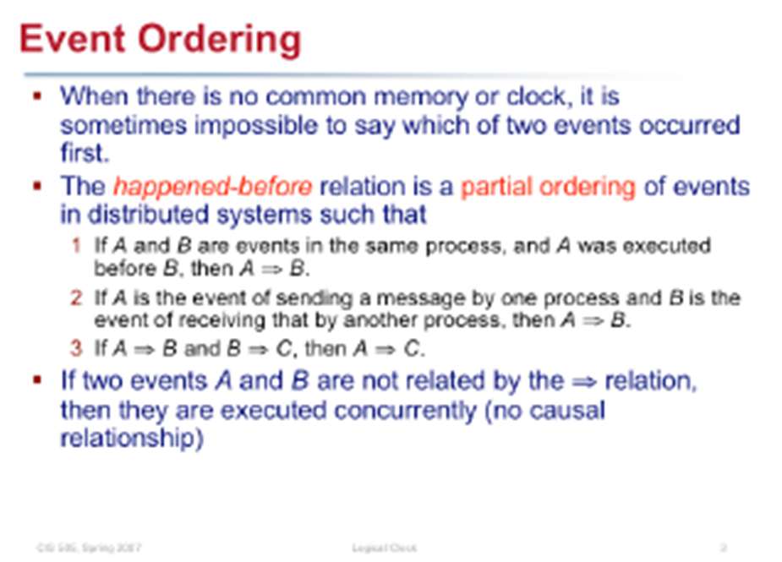

Slide 21
“Happened Before”
We define the “happened before” relation (->) as:
  a->b if a and b are events in the same process and a occurred before b.
  a->b if a is the event of sending a message m in a process and b is the event of receiving the same message m by another process.
  If a->b and b->c, then a->c, i.e., -> is transitive.
Dept. of IT, Jadavpur University

Slide 22
Causally related events & concurrent events
Causally related events: Event a causally affects event b if a->b.
Concurrent events: Two different events a and b are concurrent (denoted a||b) if a does not causally affect b and b does not causally affect a.
For any two events a and b, either a->b or b->a or a||b.
Dept. of IT, Jadavpur University

Slide 23
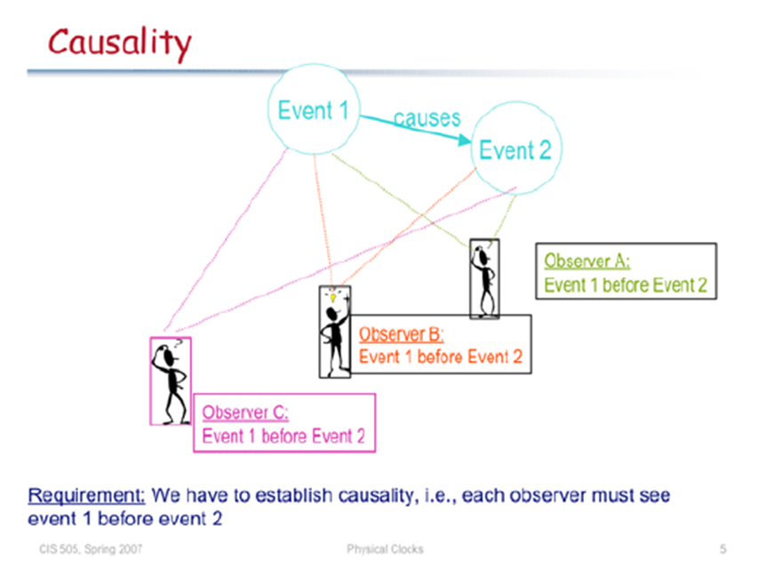

Slide 24
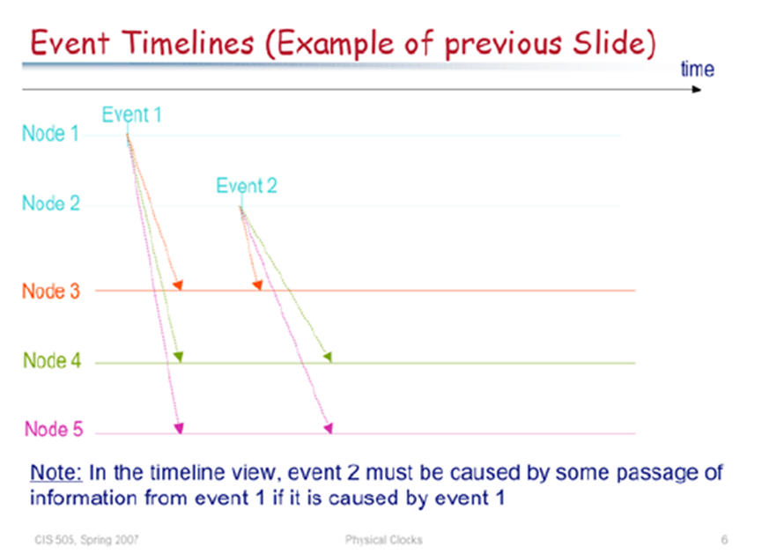

Slide 25
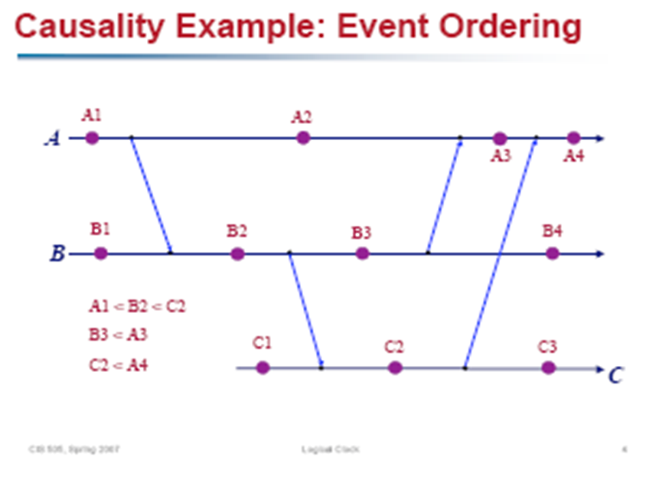

Slide 26
Lamport’s logical clock
There is a clock C_{i} at each process P_{i}.
The clock is a function that assigns a number C_{i}(a) to any event a called the timestamp of event a in process P_{i}.
It has no connection with physical time.
It assumes monotonically increasing values.
Dept. of IT, Jadavpur University

Slide 27
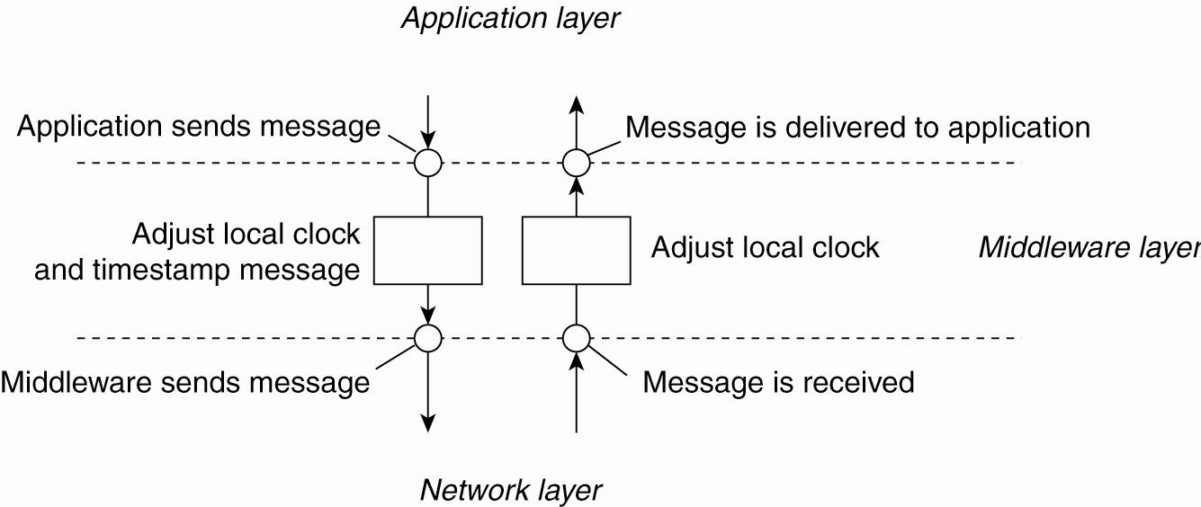
The positioning of Lamport’s logical clocks in distributed systems

Slide 28
Conditions satisfied by logical clocks
For any events a and b
  if a ->b, then we want C(a) < C(b).
The above is possible if logical clocks obey the following 2 conditions
  [C1] For any 2 events a and b in a process P_{i}, if a occurs before b, then C_{i}(a) < C_{i}(b).
  [C2] If a is the event of sending a message m in P_{i} and b is the event of receiving the same message m at process P_{j}, then C_{i}(a) < Cj(b).
Dept. of IT, Jadavpur University

Slide 29
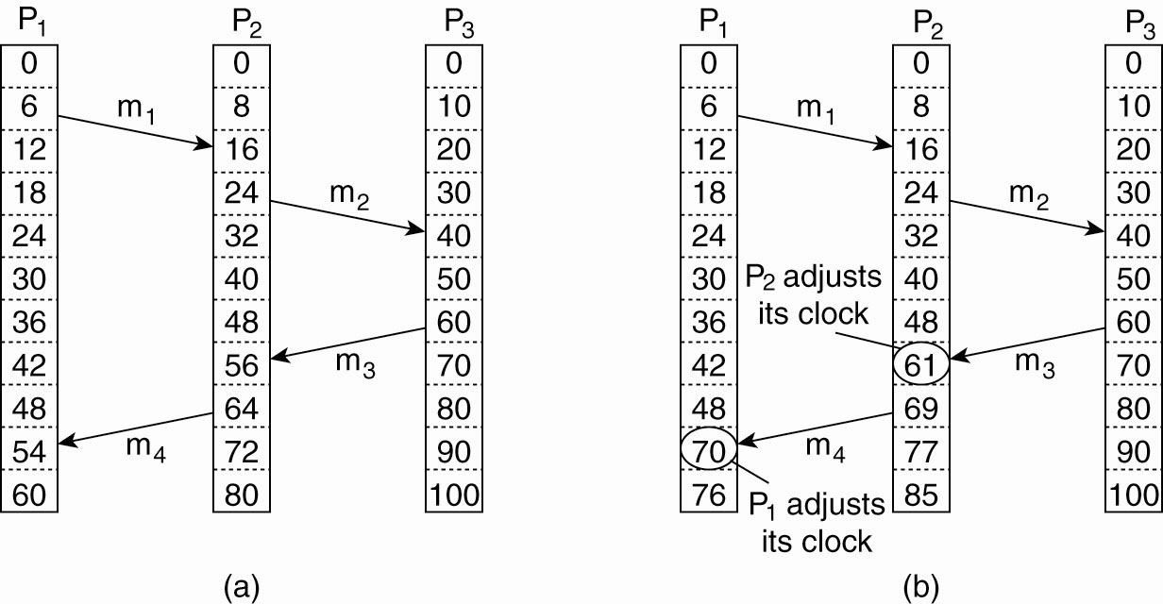
Lamport’s Logical Clocks (2)
Three processes, each with its own clock.
The clocks run at different rates.

Slide 30
Implementation rules of logical clocks
The following implementation rules guarantee the satisfaction of conditions C₁ and C₂:
  [IR1] Clock C_{i} is incremented between any two successive events (local event or message send/receive) in process P_{i}:
    C_{i} := C_{i} + d (d>0)
  If a & b are 2 successive events in P_{i} and a->b, then C_{i}(b) = C_{i}(a) + d
  [IR2] If event a is the sending of message m by process P_{i}, then message m is assigned the timestamp t_{m} = C_{i}(a). On receiving the same message m by process P_{j}, C_{j} is set as:
    C_{j} := max(C_{j}, t_{m} + d) (d>0); d is usually set to 1.
    After which it executes [IR1] and delivers m to application layer.
N.B. First apply [IR1]. Then apply [IR2].
Dept. of IT, Jadavpur University

Slide 31
Lamport’s Logical Clocks (3)
Lamport’s algorithm corrects the clocks.

Slide 32
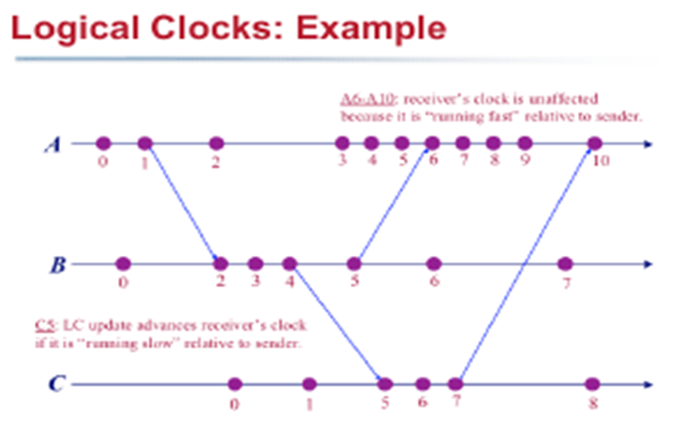

Slide 33
Partial order on events
Lamport’s “happened before” relation -> defines an irreflexible partial order (i.e., antisymmetric, transitive) among the events.
Dept. of IT, Jadavpur University

Slide 34
Limitation of Lamport’s clocks
If a -> b, C(a) < C(b)
The reverse is not necessarily true
Timestamp of e1 = (1).
Timestamp of e2 = (2)
e1 is causally related to e2
Timestamp of e6 = (2)
C(e1) < C(e6) but e1 is not causally related to e6.
e1
e2
e3
e4
e5
e6
e7
Dept. of IT, Jadavpur University

Slide 35
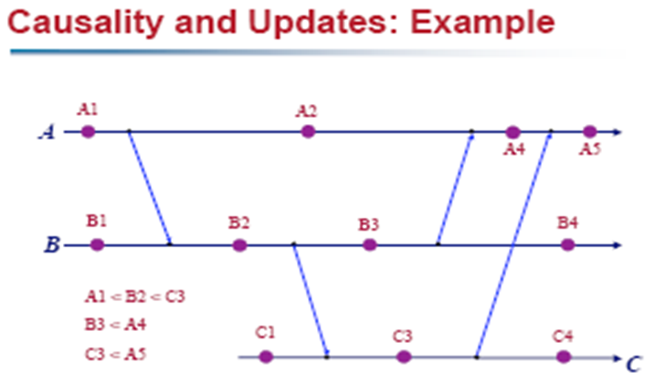

Slide 36
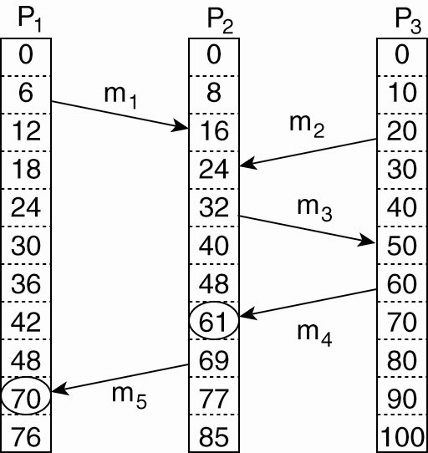
What we can conclude in general from:
If T_{rcv} (m₁) < T_{snd} (m₃) then rcv(m₁) < snd(m₃)
T_{rcv} (m₁) < T_{snd} (m₂) but the sending of m₂ has nothing to do
with receipt of m₁. Lamport clocks do not capture causality.

Slide 37
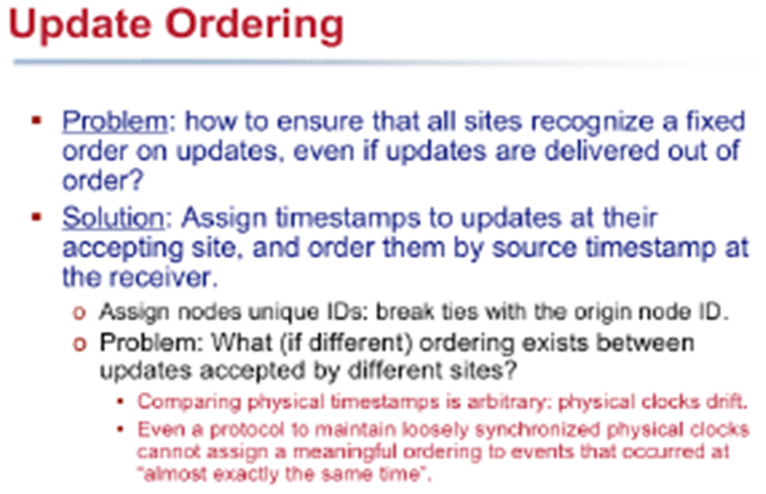

Slide 38
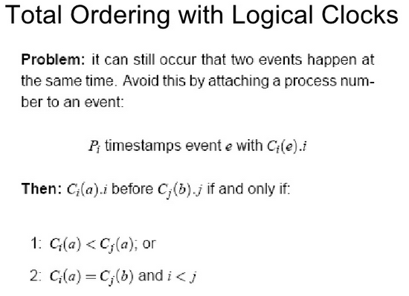

Slide 39
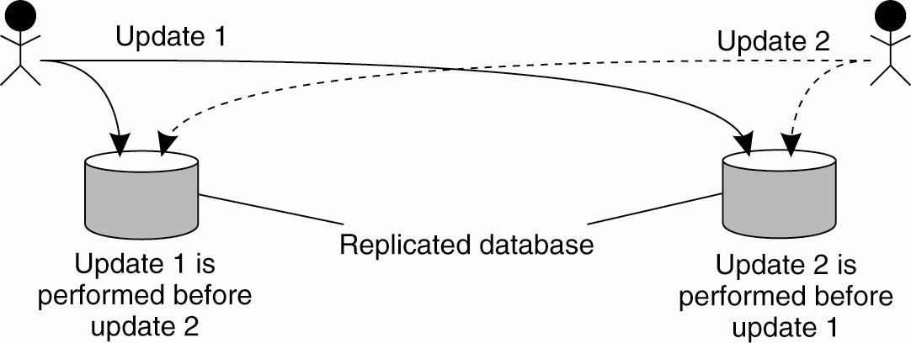
Example: Totally Ordered Multicasting
Updating a replicated database and leaving it in an inconsistent state.

Slide 40
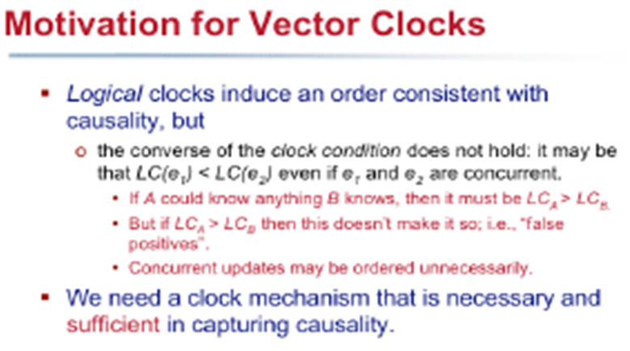

Slide 41
Vector Clocks

Slide 42
Vector Clocks
Let there be n processes in a distributed system
Each process P_{i} has a clock C_{i} which is a vector of length n.
Vector clocks are constructed by letting each process P_{i} maintain a vector VC_{i} with the following two properties:
VC_{i} [ i ] is the number of events that have occurred so far at P_{i}. In other words, VC_{i} [ i ] is the local logical clock at process P_{i} .
If VC_{i} [ j ] = k then P_{i} knows that k events have occurred at P_{j}. It is thus P_{i}’s knowledge of the local time at P_{j} .
Dept. of IT, Jadavpur University

Slide 43
Vector clocks: Implementation
The implementation rules follow:
  [IR1] Clock C_{i} is incremented between any 2 successive events (local event or message send/receive) in process P_{i}
    C_{i}[i] := C_{i}[i] + d (d>0)
  [IR2]
    If event a is the sending of message m by process P_{i}, then
      message m is assigned the timestamp t_{m} := C_{i}(a)
    When message m is received by process P_{j}, then C_{j} is updated as
    for all k, C_{j}[k] := max(C_{j}[k], t_{m}[k])
    After which it executes [IR1] and delivers m to application layer.
Comments: For each local event and each message send/receive, the logical clock advances. Each message carries as its timestamp the current vector clock value of the sender. The receiver updates its vector clock using the timestamp of the received message.
N.B. First apply [IR1]. Then apply [IR2].
Dept. of IT, Jadavpur University

Slide 44
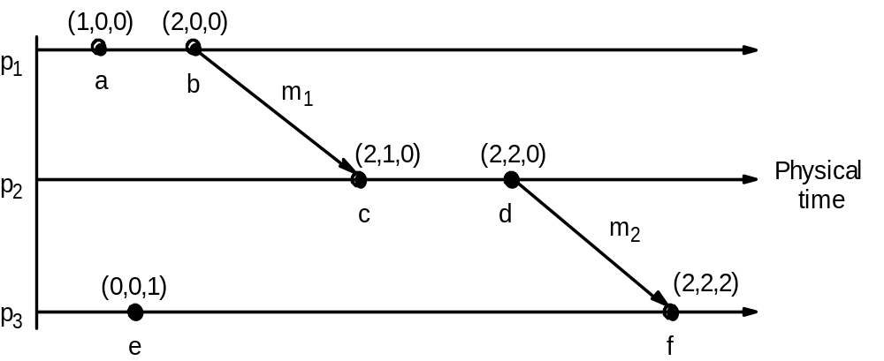
Dissemination of time in vector clocks
Dept. of IT, Jadavpur University

Slide 45
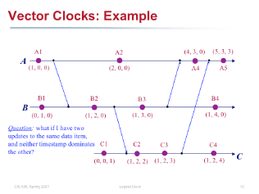

Slide 46
Causal ordering of messages
Maintain the same causal relationship that holds between “message send” events with the corresponding “message receive” events
  If Send(M1) -> Send(M2) then every recipient of both messages M1 &
  M2, Receive(M1) -> Receive(M2).
In distributed systems, causal ordering of messages is not automatically guaranteed.
  Solution: Deliver a message only if the immediately preceding message is delivered.
Dept. of IT, Jadavpur University

Slide 47
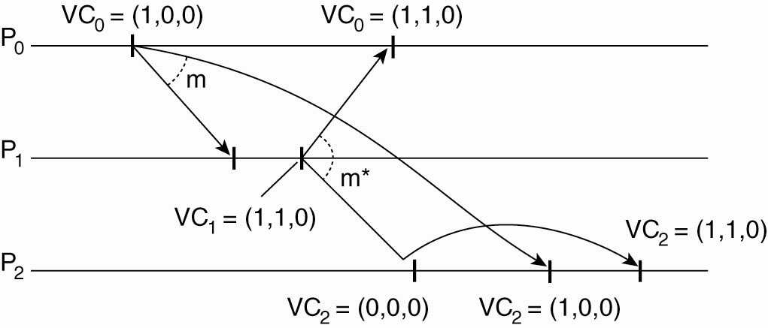
Enforcing Causal Communication
Enforcing causal communication.

Slide 48
Enforcing Causal communication
P_{j} receives a message m from P_{i} . The delivery of the message to the application layer will then be delayed until the following conditions are met.
1. ts(m)[i] =VC[i] +1, for all i
2. ts(m)[k] <= VC_{j}[k] for all k, where k!=i
The first condition states that m is the next message that P_{j} was expecting from P_{i.}
The second condition states that P_{j} has seen all the messages that have been seen by P_{i} . When it sent message m. There is no need for process P_{j} to delay the delivery of its own messages.

Slide 49
Causally related events and vector clocks
a -> b iff tª < t^{b}
Thus vector clocks allow us to order events by simply looking at their timestamps.
Dept. of IT, Jadavpur University

Slide 50
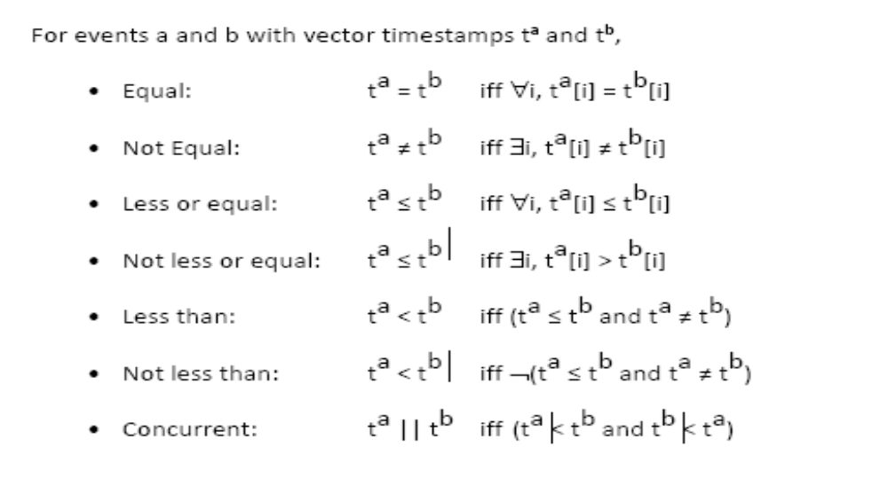
Comparing vector timestamps
Dept. of IT, Jadavpur University

Slide 51
Matrix Clocks

Slide 52
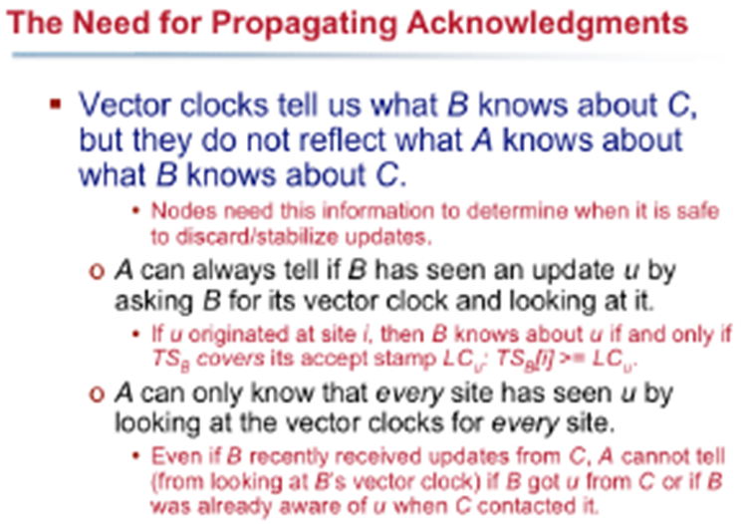

Slide 53
Matrix Clocks
Motivation:
  My vector clock describe what I “see”
  In some applications, I also want to know what other people see
Every time a message is exchanged, the sending host sends not only what it knows about the global state of time, but also the state of time that it received from other hosts.
This allows establishing a lower bound on what other hosts know, and is useful in applications such as check pointing, garbage collection, designing fault-tolerant protocols and distributed database protocols.
Matrix clock:
  Each event has n vector clocks, one for each process
  The i th vector on process i is called process i ’s principle vector
  Principle vector is the same as vector clock before
  Non-principle vectors are just piggybacked on messages to update “knowledge”

Slide 54
Matrix Clock Protocol
For principle vector C on process i
  Increment C[i] at each “local computation” and “send” event
  When sending a message, all n vectors are attached to the message
  At each “receive” event, let V be the principle vector of the sender. C = pairwise-max(C, V); C[i]++;
For non-principle vector C on process i, suppose it corresponds to process j
  At each “receive” event, let V be the vector corresponding to process j as in the received message. C = pairwise-max(C, V)

Slide 55
Matrix Clock Example
(1,0,0)
(0,0,0)
(0,0,0)
(2,0,0)
(0,0,0)
(0,0,0)
(3,0,0)
(0,0,0)
(0,0,0)
P₁
(0,0,0)
(0,1,0)
(0,0,0)
(0,0,0)
(0,2,2)
(0,0,2)
(2,0,0)
(2,3,2)
(0,0,2)
P₂
(0,0,0)
(0,0,0)
(0,0,1)
(0,0,0)
(0,0,0)
(0,0,2)
(2,0,0)
(2,3,2)
(2,3,3)
P₃

Slide 56
Matrix Clock Example
(1,0,0)
(0,0,0)
(0,0,0)
(2,0,0)
(0,0,0)
(0,0,0)
(3,0,0)
(0,0,0)
(0,0,0)
Theorem:
  On any given process, any non-principle vector is smaller than the principle vector.
(0,0,0)
(0,1,0)
(0,0,0)
(0,0,0)
(0,2,2)
(0,0,2)
(2,0,0)
(2,3,2)
(0,0,2)
(0,0,0)
(0,0,0)
(0,0,1)
(0,0,0)
(0,0,0)
(0,0,2)
(2,0,0)
(2,3,2)
(2,3,3)

Slide 57
Application of Matrix Clock
(1,0,0)
(0,0,0)
(0,0,0)
(2,0,0)
(0,0,0)
(0,0,0)
(3,0,0)
(0,0,0)
(0,0,0)
P1
order D1 = (1,0,0)
D1
P3 now knows that all 3 processes have seen D1
(0,0,0)
(0,1,0)
(0,0,0)
(0,0,0)
(0,2,2)
(0,0,2)
(2,0,0)
(2,3,2)
(0,0,2)
P2
order D2 = (0,1,0)
D1, D2, D3
D3
(0,0,0)
(0,0,0)
(0,0,1)
(0,0,0)
(0,0,0)
(0,0,2)
(2,0,0)
(2,3,2)
(2,3,3)
P3
order D3 = (0,0,1)

Slide 58
A Snack for Mind
Vector clock tells me what I know
  one-dimensional data structure
Matrix clock tells me what I know about what other people know
  Two-dimensional data structure
?? tells me what I know about what other people know about what other people know
  ??-dimensional data structure

Slide 59
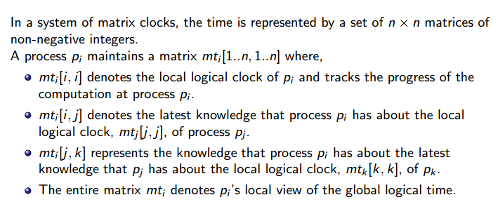
Matrix Clock(1/2)
Dept. of IT, Jadavpur University

Slide 60
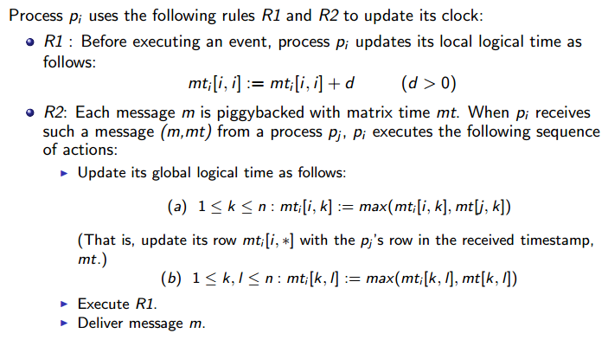
Matrix Clock(2/2)
Dept. of IT, Jadavpur University

Slide 61
Summary
Logical clock
  “happened before” ⇒ smaller clock value
Vector clock
  “happened before” ⇔ smaller clock value
Matrix clock
  Gives a process knowledge about what other processes know

Slide 62
Election Algorithms

Slide 63
Why Election Algorithm?
Many DSs require one process to act as coordinator, initiator or perform some special role.
E.g., permission based approach in distributed mutual exclusion may need a coordinator where message passing is the sole means of implementation.

Slide 64
Why Election Algorithm?
Many DSs require one process to act as coordinator, initiator or perform some special role.
E.g., permission based approach in distributed mutual exclusion may need a coordinator where message passing is the sole means of implementation.
Assumptions:
1) Each process has a unique number. E.g. network address.
2) One process is running per machine.
3) Highest process number is designated as coordinator.

Slide 65

A. Bully Algorithm
Any process say, P which notices that the coordinator is no longer responding, can start the election algorithm which is stated below:
Algorithm:

Slide 66
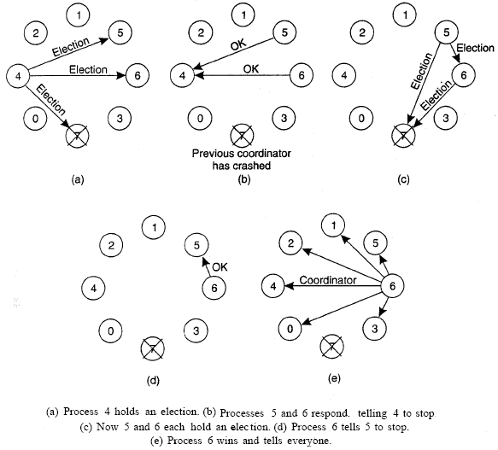
Bully Algorithm: Example

Slide 67
Pseudocode of Bully Algorithm
Background: any process Pi sends a message to the current coordinator; if no response in T time units, Pi tries to elect itself as leader. Details follow:
Algorithm for process Pi that detected the lack of coordinator
1. Process Pi sends an “Election” message to every process with higher priority.
2. If no other process responds, process Pi starts the coordinator code running and sends a message to all processes with lower priorities saying “Elected Pi”
3. Else, Pi waits for T’ time units to hear from the new coordinator, and if there is no response → start from step (1) again.
Algorithm for other processes (also called Pi)
If Pi is not the coordinator then Pi may receive either of these messages from Pj
if Pi sends “Elected Pj”; [this message is only received if i < j]
Pi updates its records to say that Pj is the coordinator.
Else if Pj sends “election” message (i > j)
Pi sends a response to Pj saying it is alive
Pi starts an election.

Slide 68
B. Ring Algorithm
Unlike some ring algorithm, this one dpes not use a token.
Process are physically or logically ordered.
Any process say, P which notices that the coordinator is not responding, can start the election algorithm.
If the successor is down, the sender skips over the successor and goes to the next member along the ring. or the one after that, until a running process is located.
At each step along the way the sender adds its own process number to the list in the message effectively making itself a candidate to be elected as coordinator.

Slide 69
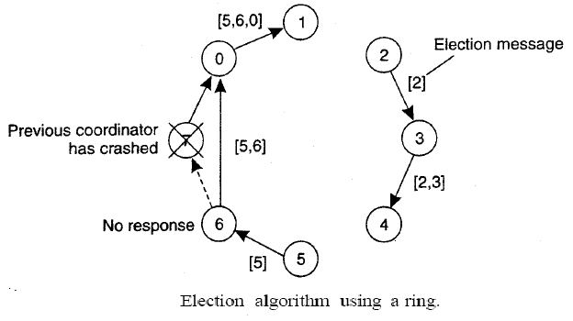
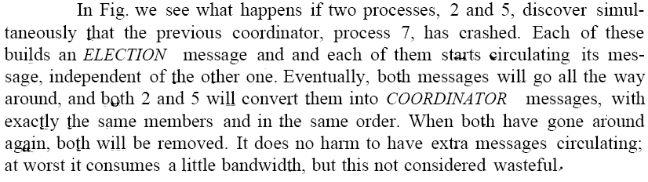
Ring Algorithm: Example1

Slide 70
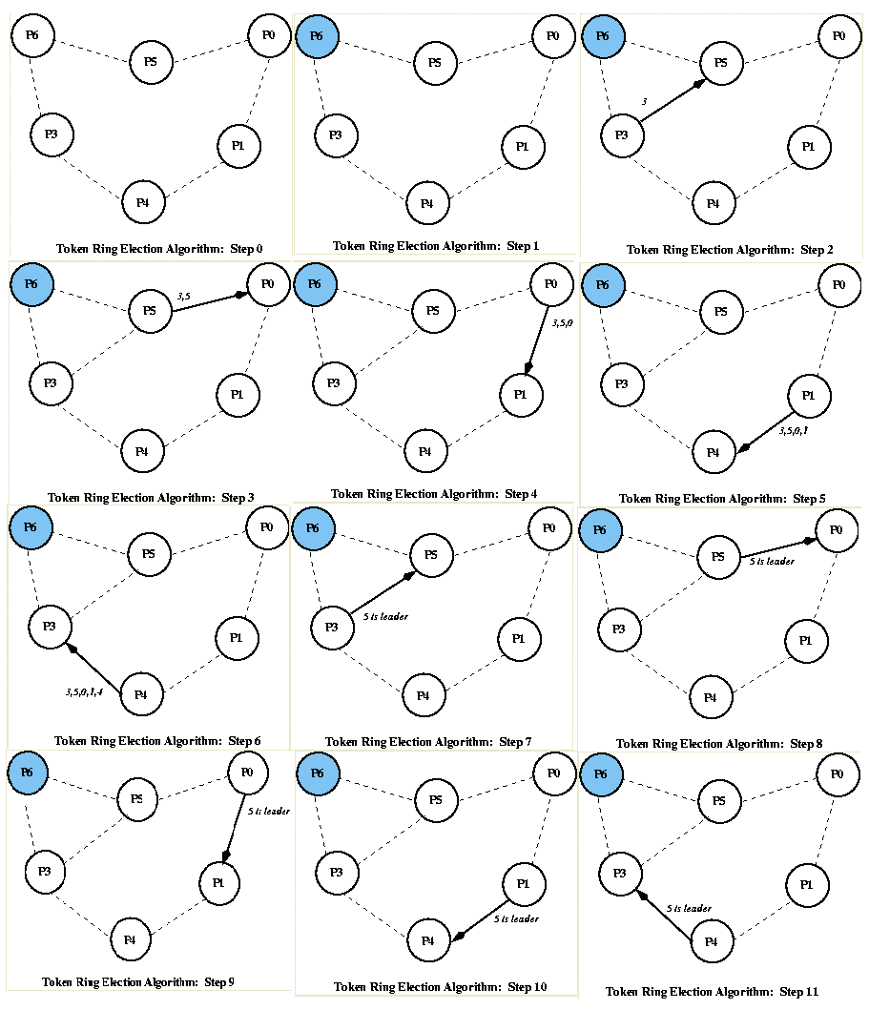
Ring Algorithm: Example2

Slide 71
Pseudocode of Ring Algorithm
-Assume that processes form a ring: each process only sends messages to the next process in the ring
- Active list: its info on all other active processes
- assumption: message continues around the ring even if a process along the way has crashed.
Background: any process Pi sends a message to the current coordinator; if no response in T time units, Pi initiates an election
1. initialize active list to empty.
2. Send an “Elect(i)” message to the right. + add i to active list.
If a process receives an “Elect(j)” message
(a) this is the first message sent or seen
initialize its active list to [i,j]; send “Elect(i)” + send “Elect(j)”
(b) if i != j, add i to active list + forward “Elect(j)” message to active list
(c) otherwise (i = j), so process i has complete set of active processes in its active list.
=> choose highest process ID + send “Elected (x)” message to neighbor
If a process receives “Elected(x)” message,
set coordinator to x

